Slide 1


Slide 2

A Personal & Leadership
Growth Journey
Offered by
LEADERSHIP

Slide 3
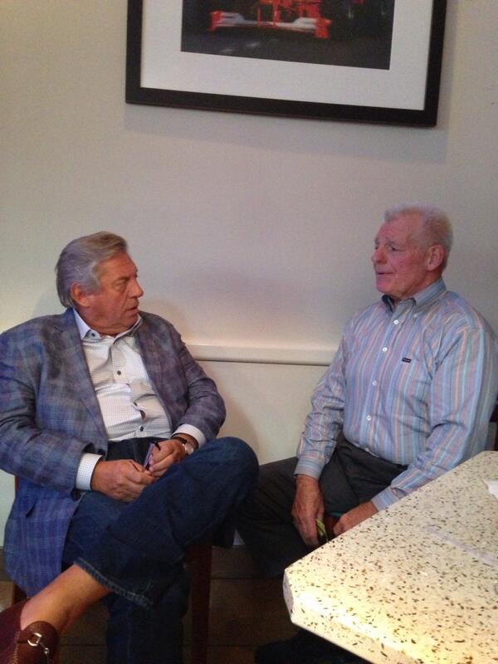
Started in 1996
By John & Larry Maxwell
Mobilizing Leaders
to Transform Their World
1st Major Initiative
Million Leader Mandate
2003-2015

Slide 4
2015- Million Leader Mandate Met
2015- Transitioned to
Transformational Leadership
through Salt & Light Initiative
2020- Beyond Success Launch
w/ focus on Africa & LATAM
2022- Global Vision Buildout

Slide 5
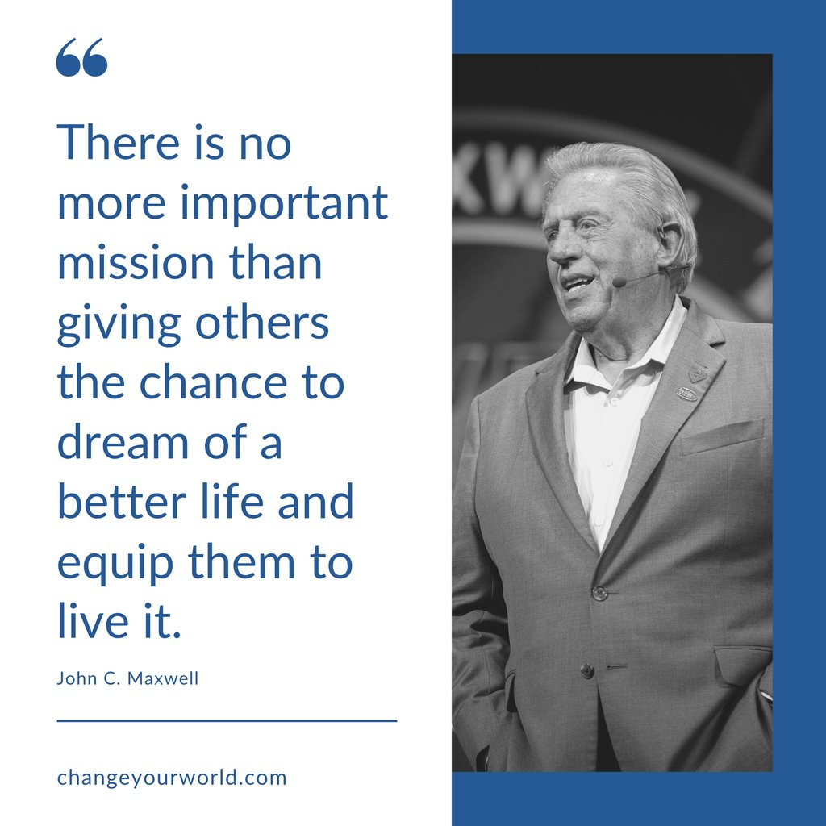

What our world needs most is people that will learn and live good values. We need leaders who will lead with good values.
A Transformational
Leadership Movement

Slide 6

THE MOVEMENT
Mobilizing leaders for transformation
by providing them
relationship and resources
that equip them to
add value to people
who will multiply value to others
through Beyond Success Tables.

Slide 7
Beyond Success Tables
6-8 people gather to learn and live good values related to successful life & leadership in a safe, open, and authentic atmosphere.
There are 7 sessions, lasting 60-90 minutes, with a facilitator-led discussion of one success value or principle each session.
Each session has an opportunity to learn from leadership expert, Dr. John C. Maxwell, gain insight into the principle, reflect on how it is showing up in your life, and commit to a small, intentional action to better live that value and principle.

Slide 8

3 Unique Keys

Slide 9


A Transformational Principle
The Values

Slide 10


The Values
Attitude
Personal Growth
Priorities
Relationships
My Most Important Relationship
From Good Intentions to Good Actions
From Success to Significance

Slide 11
A Transformative Process
The Success Table

Slide 12
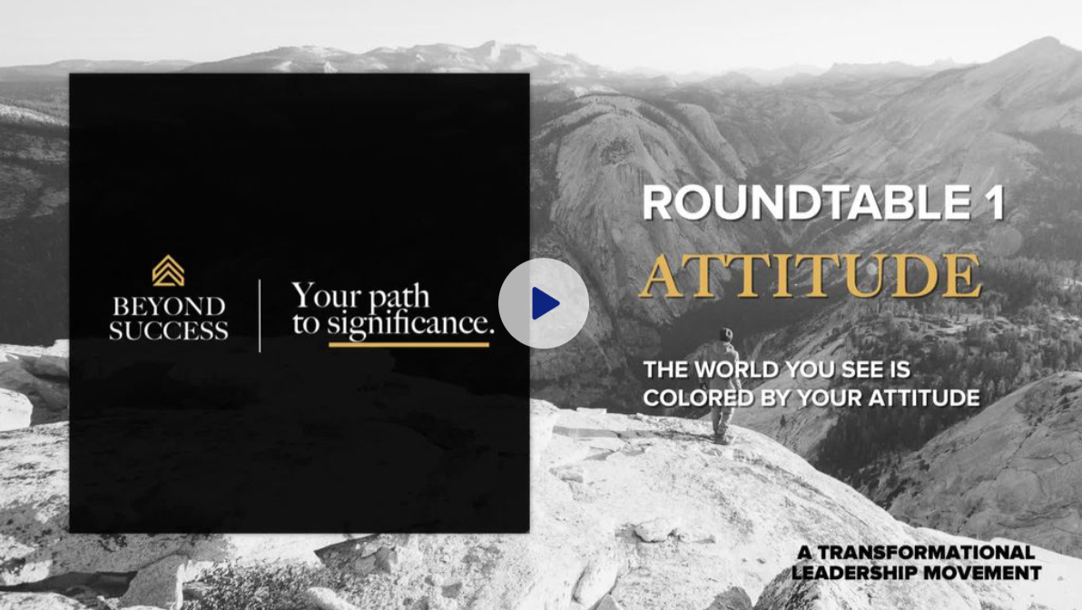
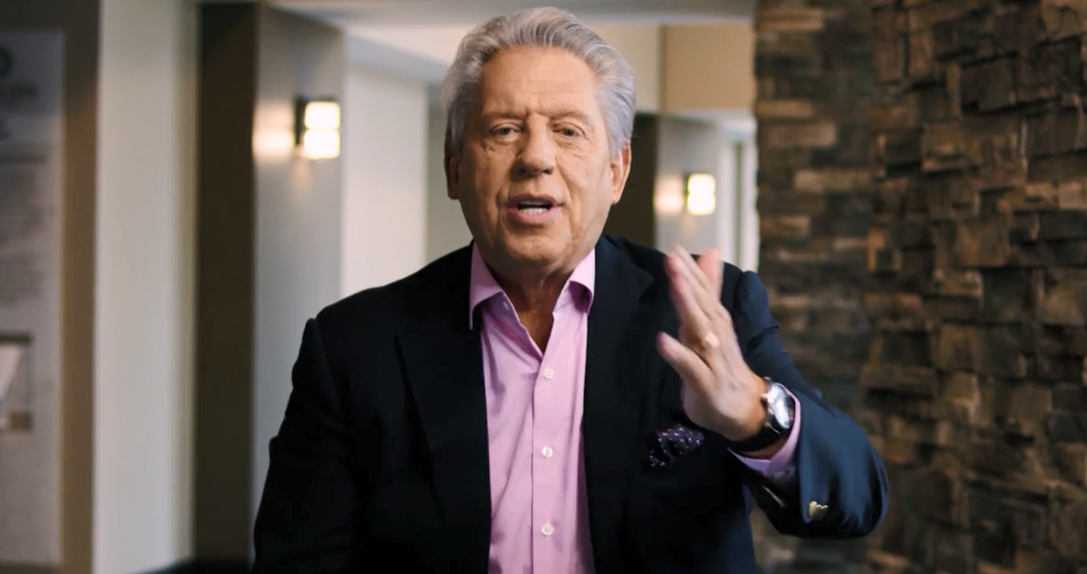

Slide 13
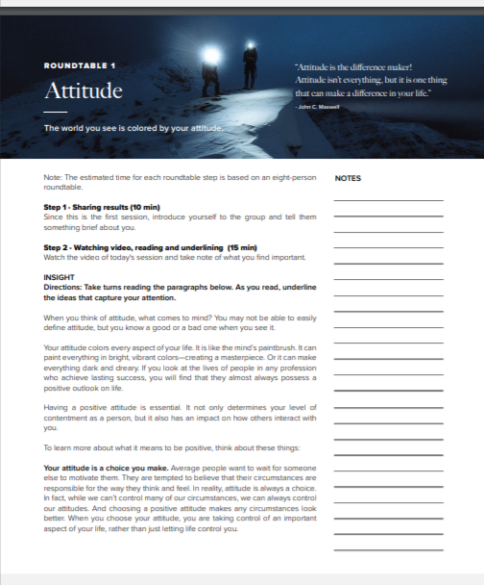
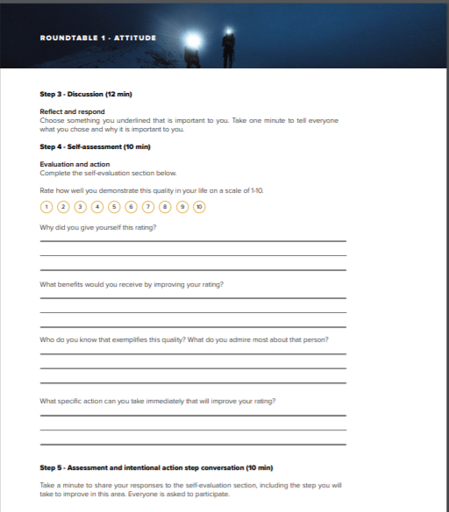

Slide 14
A Transformed Person
The Facilitator

Slide 15


The Facilitator
Is a fellow journeyer
Has experienced a Success Table
Has been trained in facilitation
Guides the experience
Has an open mind & heart
Understands how to facilitate a safe, friendly, authentic environment

Slide 16
Adding Value to People
Who Will Multiply
Value to Others

Slide 17
The Facilitator Opportunity
Join us and complete the 7 Success Tables
Attend the facilitator training table
Receive free facilitator resources
Start your first Success Table
Receive your facilitator training certificate
Become part of the Transformational Leadership Movement!

Slide 18
Join us on the growth journey

Slide 19

Contact me
For more info or to join my next Success Table
Contact Info:

